Slide 1
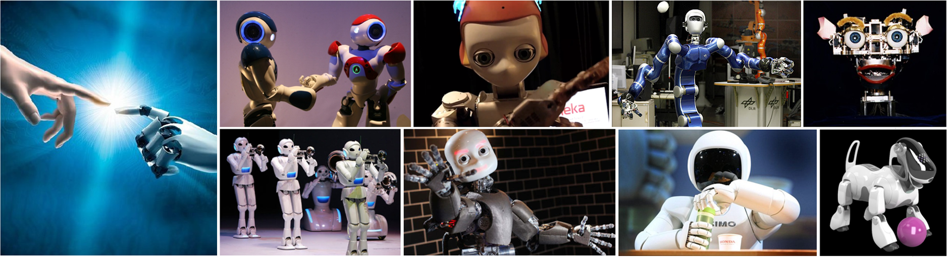
CMSC 591
Robotic Vision
Notes:
1

Slide 2
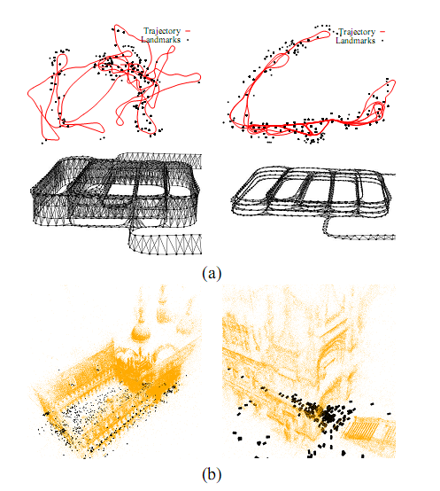
G2O Introduction
He Zhang (David)
Notes:
A general framework for graph optimization

Slide 3
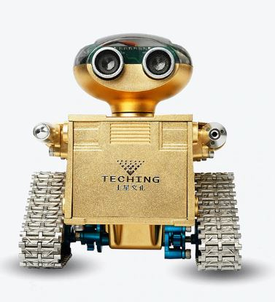
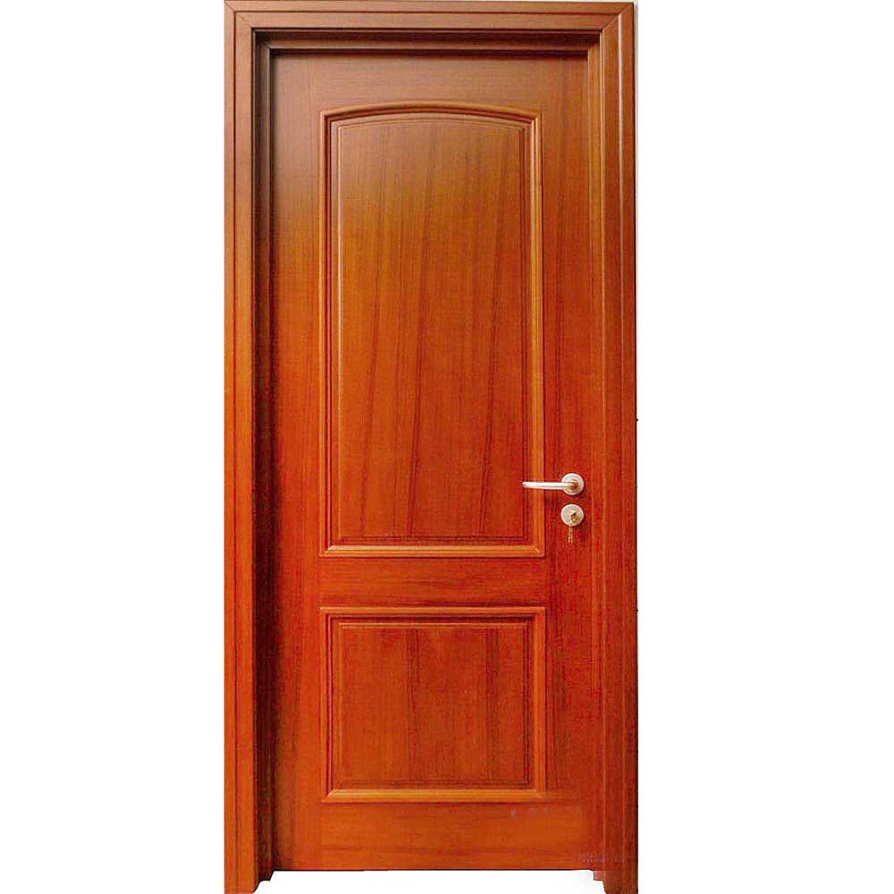
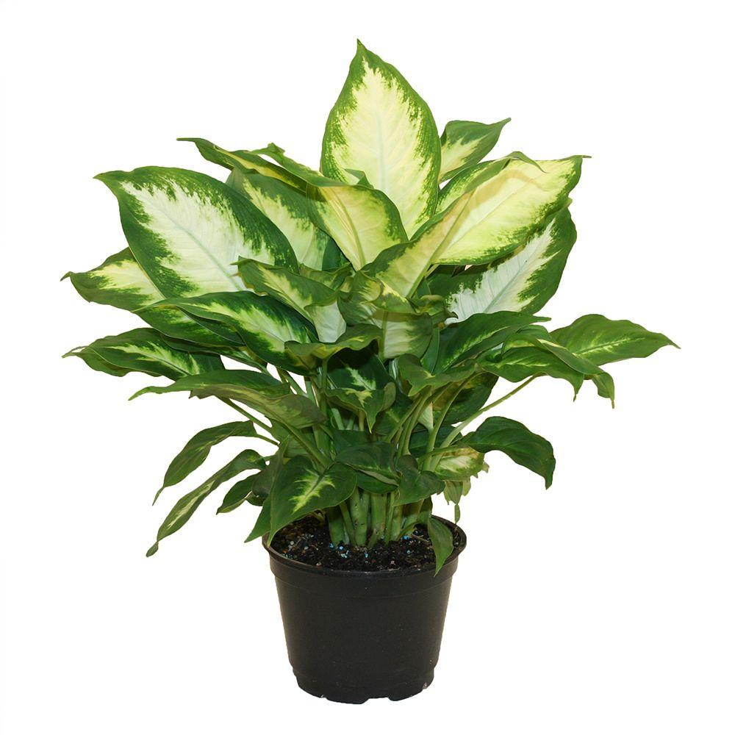
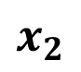
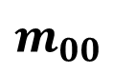
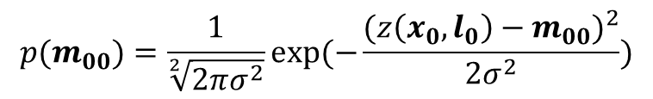
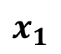
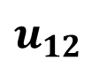
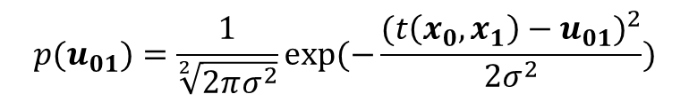
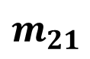

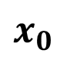
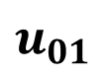
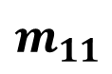
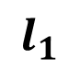
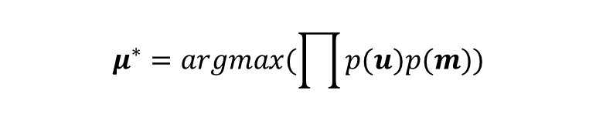
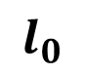
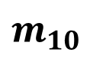
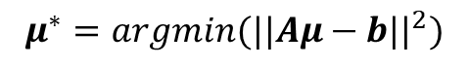
Graph SLAM in Math
$$x_{0}$$
$$x_{1}$$
$$x_{2}$$
$$u_{01}$$
$$u_{12}$$
$$m_{11}$$
$$p(u_{01})=\frac{1}{\sqrt[2]{2πσ^{2}}}exp⁡(−\frac{{(t\left(x_{0},x_{1}\right)−u_{01})}^{2}}{2σ^{2}})$$
$$m_{21}$$
$$m_{00}$$
$$m_{10}$$
$$p(m_{00})=\frac{1}{\sqrt[2]{2πσ^{2}}}exp⁡(−\frac{{(z\left(x_{0},l_{0}\right)−m_{00})}^{2}}{2σ^{2}})$$
$$l_{0}$$
$$l_{1}$$
$$μ^{∗}=argmax(\prod{p(u)p(m)})$$
Iteratively Solve Linearized System
$$μ^{∗}=argmin(\sum{e^{T}Σ^{−1}e})$$
$$μ^{∗}=argmin({||Aμ−b||}^{2})$$
Where $e\left(u_{01}\right)=t\left(x_{0},x_{1}\right)−$ $u_{01}$, $e\left(m_{00}\right)=z\left(x_{0},l_{0}\right)−m_{00}$

Slide 4
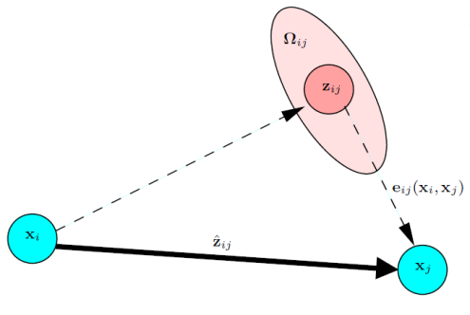
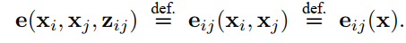
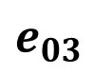
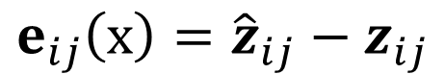
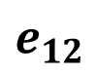
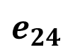
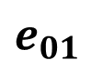
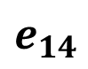
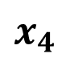
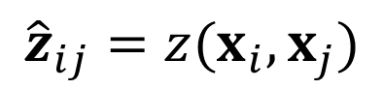
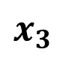
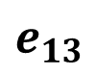
G2O Model
$$x_{0}$$
$$x_{1}$$
$$x_{2}$$
$$e_{01}$$
$$e_{12}$$
$$e_{14}$$
$$e_{24}$$
$$e_{03}$$
$$e_{13}$$
$$x_{3}$$
$$x_{4}$$
$$e_{ij}\left(x\right)={\hat{z}}_{ij}−z_{ij}$$
$${\hat{z}}_{ij}=z(x_{i},x_{j})$$
Notes:
In G2O, all the variables are generally treated as nodes, representing the parameters to be estimated. They are denoted as x. An edge is represented by the residual error of its constraint, which is denoted by e. Each constraint is modeled like this figure. The zij and Omega represent the mean and information matrix of a constraint relating to the parameters xi and xj. Z hat ij, represents the estimator for the mean value of this measurement constraint. This constraint could be a odometry measurement, or a landmark measurement.
The difference between the estimator z hat ij and the true mean value is called the residual error.

Slide 5
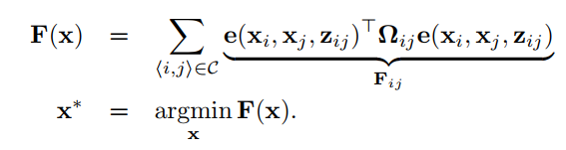

The problem of G2O
Notes:
Here, x = (x> 1 , . . . , x> n )> is a vector of parameters, where each xi represents a generic parameter block, zij and Ωij represent respectively the mean and the information matrix of a constraint relating the parameters xj and xi, and e(xi, xj, zij) is a vector error function that measures how well the parameter blocks xi and xj satisfy the constraint zij. It is 0 when xi and xj perfectly match the constraint
Remember that in the previous class, the graph optimization process will iteratively try to find out the optimal solution that minimize the cost function, like this figures shows. Next we show how to use Gauss-Newton to solve this nonlinear least square problem.

Slide 6
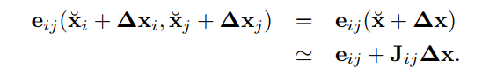
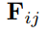
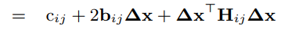
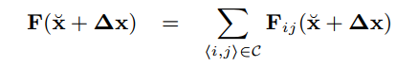
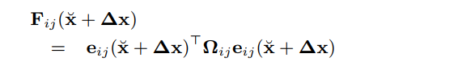
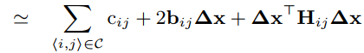
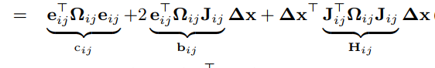
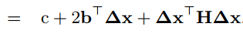
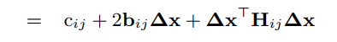
The problem of G2O
Notes:
The idea is to approximate the error function by its first order Taylor expansion around the current initial guess x. Given small disturbance for the parameter xi and xj, the cost function can be estimated by this linear model, where Jij is the jacobian matrix estimated at x.
Then the error terms Fij can be written as
Approximate equal is used here because of linearization

Slide 7
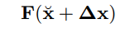
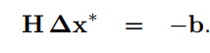
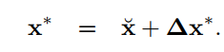
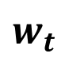
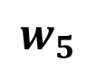

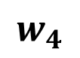
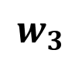
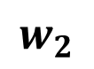

Gauss Newton
$$w_{2}$$
$$w_{4}$$
$$w_{3}$$
$$w_{0}$$
$$w_{t}$$
$$w_{1}$$
$$w_{5}$$
Notes:
With the local approximation, we can rewrite the cost function F(x) as

Slide 8





Levenberg-Marquardt
$F\left(x+∆x\right)>F\left(x\right),$revert and increase $λ$
$F\left(x+∆x\right)≤F\left(x\right),$continue and decrease $λ$
$$w_{4}$$
$$w_{3}$$
$$w_{0}$$
$$w_{t}$$
$$w_{1}$$
$$w_{2}$$
Notes:
Here, x = (x> 1 , . . . , x> n )> is a vector of parameters, where each xi represents a generic parameter block, zij and Ωij represent respectively the mean and the information matrix of a constraint relating the parameters xj and xi, and e(xi, xj, zij) is a vector error function that measures how well the parameter blocks xi and xj satisfy the constraint zij. It is 0 when xi and xj perfectly match the constraint
Remember that in the previous class, the graph optimization process will iteratively try to find out the optimal solution that minimize the cost function, like this figures shows. Next we show how to use Gauss-Newton to solve this nonlinear least square problem.

Slide 9

Minimal Parameterization
Euclidean Space
Non Euclidean Space parameters
unit vector $\overline{n}=[n_{x},n_{y},n_{z}]$, DoF (2), span SO(2)
quaternion $\overline{q}=[q_{x},q_{y},q_{z},q_{w}]$, DoF (3), span SO(3)
Over-parameterization problem
Singular
Notes:
The procedures described above are general approaches to multivariate function minimization. They assume that the space of parameters x is Euclidean. This assumption is not valid for SLAM problems.
Parameters that span non-Euclidean space, they cannot be simply added together. For example, the normal vector of a plane, it has three components, while its degree of freedom is only two since its normal is constraint to be 1. It spans the non-Euclidean 2D or 3D rotation group SO(2).
# Other examples are homographic representation of a image point, and also quaternions, etc.
Such Cases usually have more components than their actual degree of freedom, directly adding them into graph to optimize will cause the over-parameterization problem. It means you have redundant parameters in your model. For a overparameterized system, the information matrix will be singular, and any attempt to invert it within gauss-newton will fail. Although, Levenberg-Marquardt can mitigate this issue by adding a regularization term, this could negative affect its converge speed.
So, a better and more decent solution is minimal parameterization. The core idea is that, the increment/perturbation dx is not computed in their own space, instead, dx is computed in their tangent space. Let’s take the normal vector for example.
Let’s see this figure,

Slide 10





SO(2)
$$\overline{n′}$$
$$∆x$$
$$∆x$$
$$\overline{n}$$

Slide 11




Minimal Parameterization
Nonlinear Operator
Notes:
To tackle this problem, in G2o, a nonlinear operator is defined to generalize the update for parameters over non-Euclidean space. For example, if x represents only translation, the operation is equal to plus. If x represents both translation and rotation, this operation equal to standard motion composition operator. So you need to define this operation in your own application.
But the math behind is to compute the jacobian of the cost function with respect to the increment dx in the tangent space of the variable.

Slide 12


Minimal Parameterization
Nonlinear Operator
Notes:
Given the nonlinear operator, the error term e() can be rewritten as this . Notice that here the jacobian Jij is different. Since it is computed in the tangent space of x, not in the space of x. So when dx is solved, it has to be mapped to the original space of x using this nonlinear operator again.
Optimization problem becomes

Slide 13






Structure of Linearized System
Gauss Newton
Levenberg Marquardt
$$μ=A^{−1}∗b$$
Notes:
Now let’s dive into the structure of the information matrix H and residual vector b.
the matrix H and the vector b are obtained by summing up a set of matrices and vectors
The structure of this addend depends on the Jacobian of the error function. Since the error function of a constraint depends only on the values of two nodes, the Jacobian.
Here Aij and Bij are the derivatives of the error function with respect to ∆xi and ∆xj.
Then we can obtain the following structure for the block matrix Hij, does it seem to be familiar to you, it is nothing magic. Last class we learn how to solve this graph problem? Just compute the information matrix A and the residual vector b, here it’s the same concept.
For simplicity of notation we omitted the zero blocks. You might notice that the block structure of the matrix H is the adjacency matrix of the graph. Thus, it has a number of non-zero blocks proportional to number of edges in the graph. This typically results in sparse H matrices. G2o take advantage of this characteristic of H by utilizing state-of-the-art approaches to solve the linear system this equation.

Slide 14

G2O Framework
Notes:
This is a overview about the G2O framework. From the beginning, the error function of the edge constraints need to be defined. Also, the nonlinear add operator needs to be defined. Next, the jacobian, In G2O, in default, it provides numeric jacobian, so its optional to write your own jacobian. If you do that, it will reduce computation cost and increase speed. In g2o, it use Levenberg Marquardt algorithm. The linear solver and the linear structure are provided. You can choose one of them.
So, to address a new optimization problem, only the boxes in blue rectangle need to specified. If your parameters are in the Euclidean space, you even do not need to specify the nonlinear add operator.
The jacobian is optional. For the others, you can choose by setting certain parameters, which I will show you later. So, you can notice that G2O is very easy to use. You need to understand your problem and defines the error functions of your variables in different constraints.

Slide 15


Application Example: G2O Based SLAM method for SmartCane Project
H. Zhang and C. Ye, "An Indoor Wayfinding System based on Geometric Features Aided Graph SLAM for the Visually Impaired," IEEE Transactions on Neural Systems and Rehabilitation Engineering, vol. 25, no. 9, pp. 1592-1604, 2017

Slide 16













Plane-Aided Graph SLAM
Floor plane in Graph Structure
Parameterization of Plane
$$Z$$
$$n_{k}^{}$$
$$O_{k}^{}$$
$$d_{k}^{}$$
$$O$$
$$β_{k}^{}$$
$$Y$$
$$α_{k}^{}$$
$$X$$
$n_{k}^{}$ is the normal vector of plane K
A graph with 5 P-nodes and 1 FP-node for
PAG-SLAM (Plane Aided Graph SLAM)
$$e_{ik}^{f}=z_{ik}^{f}−{\hat{z}}_{ik}^{f}=\left[\begin{matrix}α_{k}^{i} \\ \begin{aligned}β_{k}^{i} \\ d_{k}^{i}\end{aligned}\end{matrix}\right]−\left[\begin{aligned}\begin{matrix}{\hat{α}}_{k}^{i} \\ {\hat{β}}_{k}^{i}\end{matrix} \\ {\hat{d}}_{k}^{i}\end{aligned}\right]$$
Edge between P-nodes computed from VRO
Edge between P-node and FP-node computed from plane model defined in the right
$$C_{π_{k}^{i}}=F_{q}\left(\begin{matrix}Σ_{q_{1}} & ⋯ & 0 \\ ⋮ & ⋱ & ⋮ \\ 0 & ⋯ & Σ_{q_{m}}\end{matrix}\right)F_{q}^{T}$$
Add Floor Plane to reduce pitch, roll, and z pose errors
Notes:
The parameters of a plane involve a normal vector, and a distance between the original point to the plane. The error for the plane measurement is given by the difference between the plane’s normal vector and distance. The covariance of the plane measurement is estimated using the standard error propagation function.
The right figure shows an example with 5 pose nodes and 1 Floor plane node. By adding the floor plane into the graph structure, we can reduce roll, pitch and z errors through graph optimization.
Another alternative representation uses the azimuth and elevation angles to represent the surface normal direction. We choose the angular representation because it has the true dof with regards to a plane.

Slide 17




Line-Aided Graph SLAM
Lines in Graph Structure
Parameterization of Line in 2D floor-plan
A graph with 5 P-nodes and 3 L-nodes for LAG-SLAM (Line Aided Graph SLAM)
$$e_{ik}^{l}=z_{ik}^{l}−{\hat{z}}_{ik}^{l}=\left[\begin{matrix}α_{ik}−α_{k}+φ \\ d_{ik}+x\cos{α_{k}}+y\sin{α_{k}}−d_{k}\end{matrix}\right]$$
Edge between P-nodes computed from VRO
Edge between P-node and L-node computed from line model defined in the right
$$C_{l_{k}^{i}}=F_{pt′}\left(\begin{matrix}Σ_{{pt}_{1}}^{l′} & ⋯ & 0 \\ ⋮ & ⋱ & ⋮ \\ 0 & ⋯ & Σ_{{pt}_{m}}^{l′}\end{matrix}\right)F_{pt′}^{T}$$
Add Wall lines to reduce yaw, x and y errors
Notes:
The parameters of a line involve an angle alpha, between the line normal direction and the X axis, and a distance between the original point and the line. The error and covariance of the line measurement is then computed. The right figure shows an example with 5 pose nodes and 3 line nodes.
By adding the wall lines of the floor plan into the graph structure, we can yaw and x y errors.

Slide 18

Task: Swing Smartcane from copy room to room 555
H. Zhang and C. Ye, "An Indoor Wayfinding System based on Geometric Features Aided Graph SLAM for the Visually Impaired," IEEE Transactions on Neural Systems and Rehabilitation Engineering, vol. 25, no. 9, pp. 1592-1604, 2017

Slide 19
demo

Slide 20
Materials
https://github.com/rising-turtle/slam_course
Kümmerle, Rainer, et al. "g2o: A general framework for graph optimization." IEEE International Conference on Robotics and Automation., 2011.
g2o manual
Joan Sol`, “Course on SLAM”, 2016
Förstner, Wolfgang. "Minimal representations for uncertainty and estimation in projective spaces." Asian Conference on Computer Vision. Springer, Berlin, Heidelberg, 2010.

Slide 21




Bundle Adjustment
Schur complement
Robot pose
$$S_{PP}$$
Landmark positions

